Slide 1
ASP.NET TECHNOLOGY
INTODUCTION TO ASP .NET WEB FORM

Slide 2
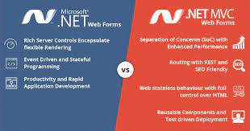

Introduction To ASP.NET Web forms

Slide 3

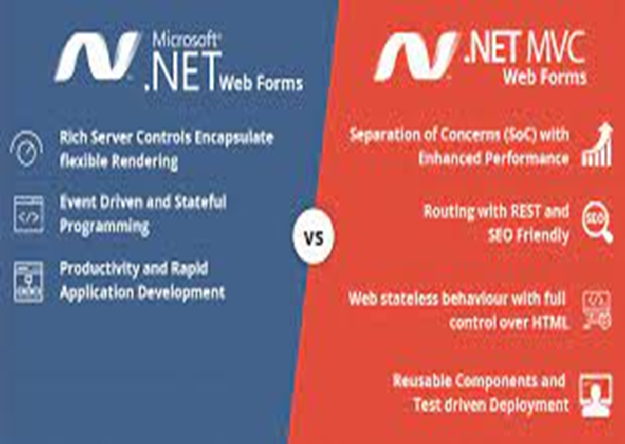
What is ASP.NET Web Form?
ASP.NET Web Forms is a part of the ASP.NET web application framework and is included with VISUAL STUDIO.It is one of the four programming models you can use to create ASP.NET web applications, the others are ASP.NET MVC, ASP.NET Web Pages, and ASP.NET Single Page Applications.

Slide 4
Features of ASP.NET Web Forms
Server Controls- ASP.NET Web server controls are objects on ASP.NET Web pages that run when the page is requested and that render markup to the browser. Many Web server controls are similar to familiar HTML elements, such as buttons and text boxes. Other controls encompass complex behavior, such as a calendar controls, and controls that you can use to connect to data sources and display data.
Master Pages- ASP.NET master pages allow you to create a consistent layout for the pages in your application. A single master page defines the look and feel and standard behavior that you want for all of the pages (or a group of pages) in your application. You can then create individual content pages that contain the content you want to display. When users request the content pages, they merge with the master page to produce output that combines the layout of the master page with the content from the content page.
Working with Data- ASP.NET provides many options for storing, retrieving, and displaying data. In an ASP.NET Web Forms application, you use data-bound controls to automate the presentation or input of data in web page UI elements such as tables and text boxes and drop-down lists.

Slide 5
Features of ASP.NET Web Forms
Routing- URL routing allows you to configure an application to accept request URLs that do not map to physical files. A request URL is simply the URL a user enters into their browser to find a page on your web site. You use routing to define URLs that are semantically meaningful to users and that can help with search-engine optimization (SEO).
State Management- ASP.NET Web Forms includes several options that help you preserve data on both a per-page basis and an application-wide basis.
Security- An important part of developing a more secure application is to understand the threats to it. Microsoft has developed a way to categorize threats: Spoofing, Tampering, Repudiation, Information disclosure, Denial of service, Elevation of privilege (STRIDE). In ASP.NET Web Forms, you can add extensibility points and configuration options that enable you to customize various security behaviors in ASP.NET Web Forms.

Slide 6
Advantages of a Web Forms
It supports an event model that preserves state over HTTP, which benefits line-of-business Web application development. The Web Forms-based application provides dozens of events that are supported in hundreds of server controls.
It uses a Page Controller pattern that adds functionality to individual pages. For more information, see Page Controller on the MSDN Web site.
It uses view state or server-based forms, which can make managing state information easier.
It works well for small teams of Web developers and designers who want to take advantage of the large number of components available for rapid application development.
In general, it is less complex for application development, because the components (the Page class, controls, and so on) are tightly integrated and usually require less code than the MVC model.

Slide 7


